Slide 1
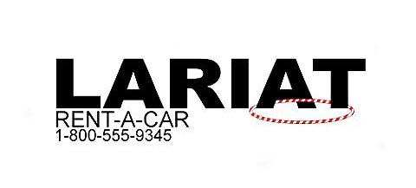

Profit Optimization Analysis
Goal: Maximize revenue and minimize cost to optimize profits
Notes:
Hello, welcome to this presentation
We’re going to be discussing ways Lariat can optimize it’s profits by maximizing revenue and minimizing costs

Slide 2
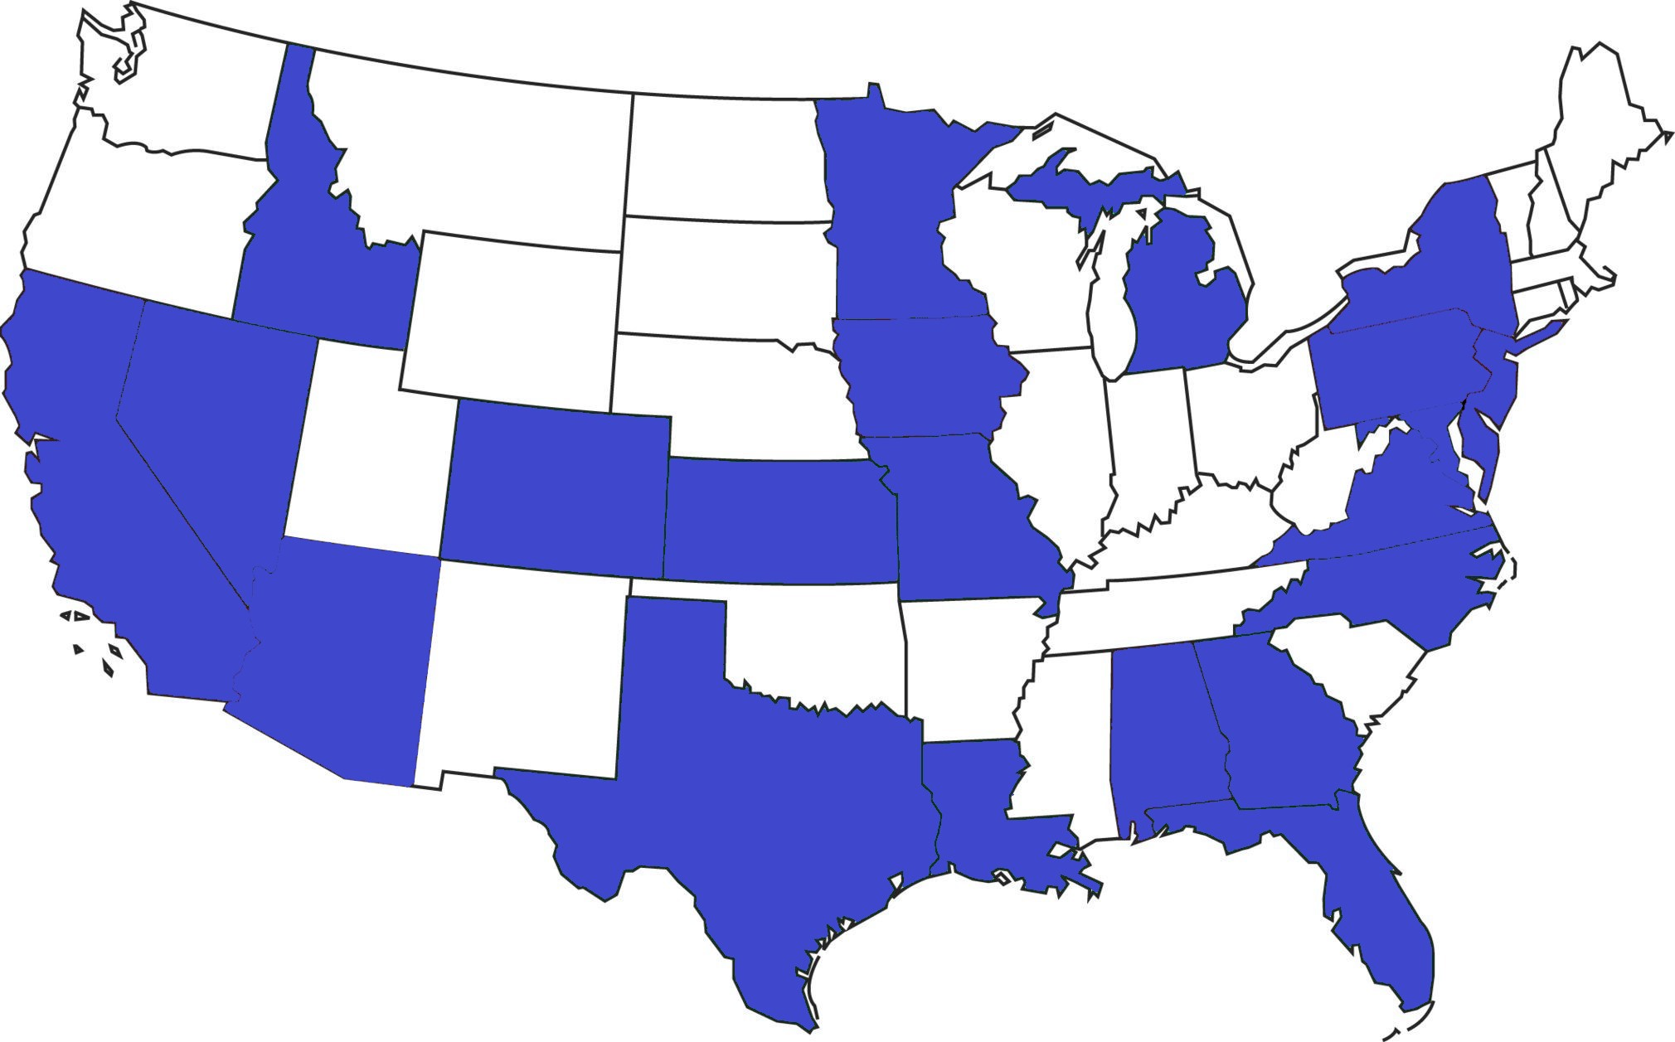
Performance
22 states
50 branches
4000 car fleet
$19.7 mill profit 2018
Notes:
- Very impressive

Slide 3
Strategies
1. Maximize revenue by boosting key performance indicators (KPI’s)
2. Minimize costs by removing unprofitable cars
Notes:
We’ll look at KPI’s in a second
We’re going to look at different ways to perform these two strategies

Slide 4
Branch Revenue Formula- KPI’s
(Average Price per Day) * (Average Number of Days per Trip) * (Number of Trips)
Notes:
When we’re discussing optimizing KPI’s, we look at from an individual branch perspective since the branches have certain performance metrics to meet and that is what we want to target
This formula will roughly give you the revenue you can expect a branch to bring in
Average price- how much is Lariat charging per day
Number of Trips- how many customers is Lariat attracting to the business
These are the two KPI’s we’re looking at, so when I mention KPI’s, this is what I’m talking about: Average price per day and number of trips

Slide 5

Strategy 1A: General Improvement
Assume 2% improvement in KPI’s
$2.1Mill profit increase
Potentially unrealistic
Notes:
2% improvement in KPI’s across the board for all the branches
Great profit increase for 2% improvement
Might be an issue because we could be asking for unrealistic numbers, untested numbers
Our best branches are expected to do 2% better, might not be possible
Our worst branches might be able to do 5% better and our best branches only 1%

Slide 6

Strategy 1B- Targeted Metrics
All branch’s hit KPI targets
Number of Trips: 1626
Avg Price per Day: $162.26
$629K profit increase
Notes:
Set specific KPI targets and assume that all the branch’s hit these targets
(read outloud the #’s chosen) - These were chosen because they’re averages and proven numbers- half our branches hit them
629k is less but it’s still good and more reasonable to expect

Slide 7
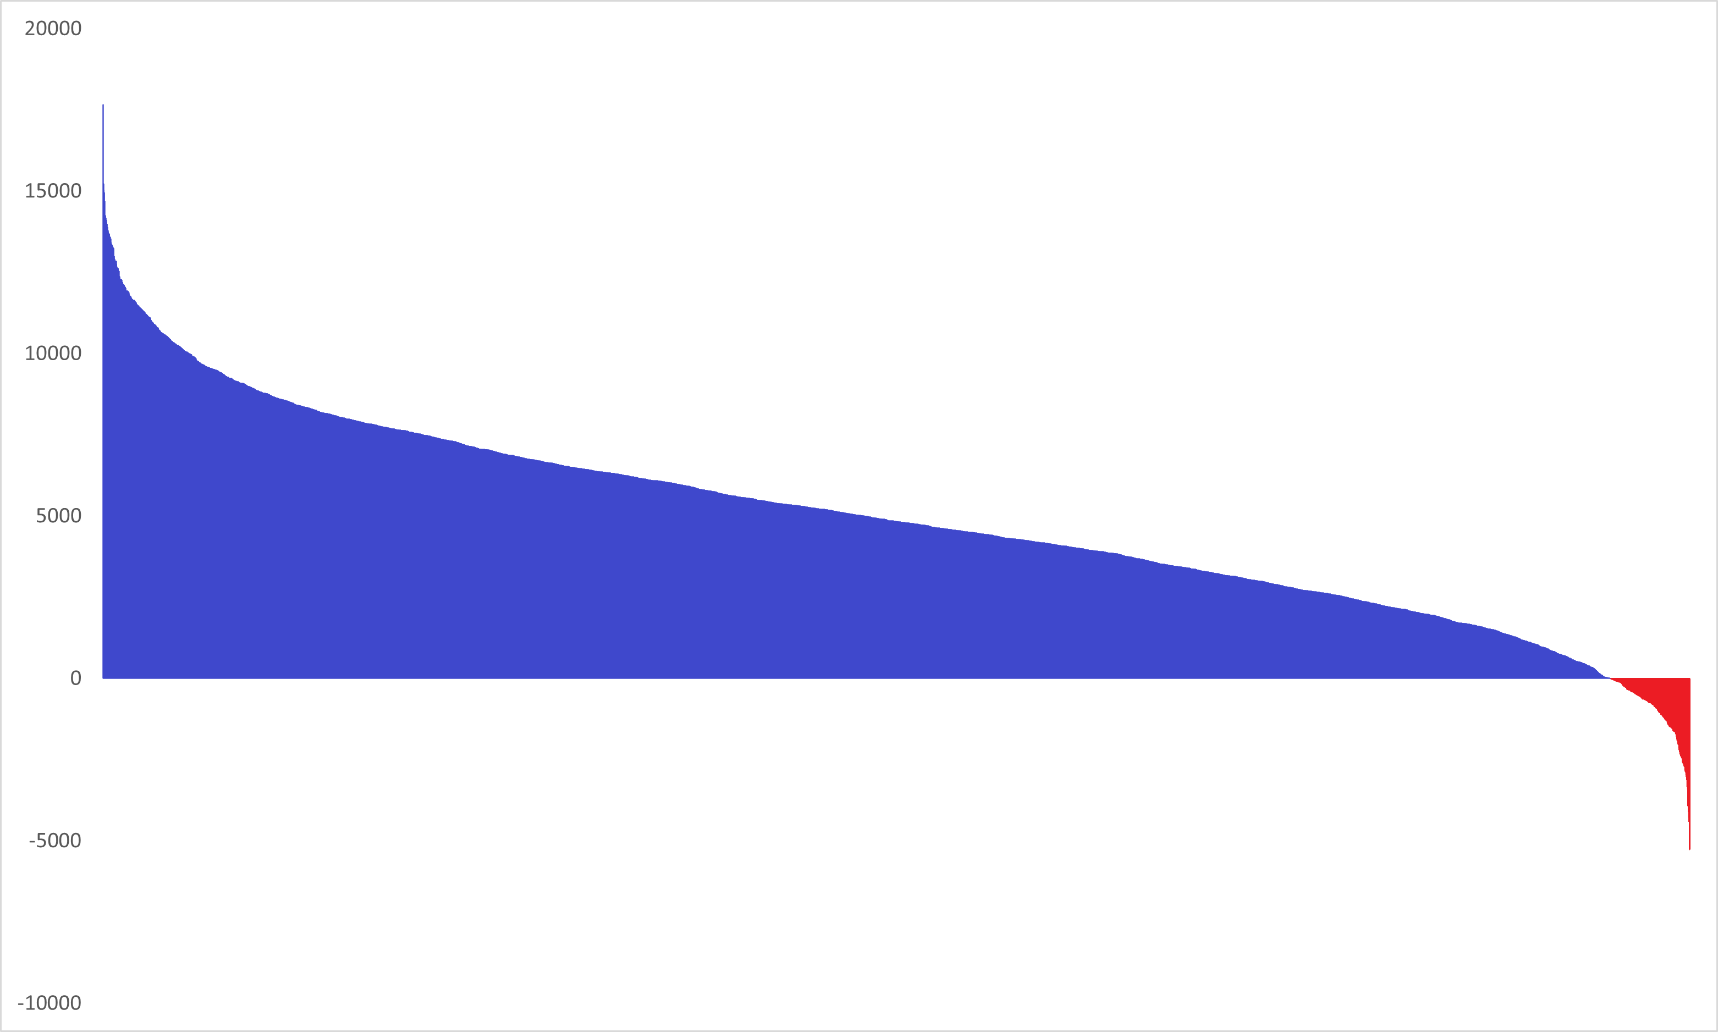
Strategy 2A- Remove Unprofitable Cars
200 unprofitable cars
$210K profit increase
Future potential?
Notes:
Lariat is very efficient
Only 200 cars out of 4000 are unprofitable
Getting rid of them gets you a 210k increase
Problem is that some of these cars might be profitable in the future
We want a strategy that can be implemented year after year
How can we determine which unprofitable cars are actually unprofitable?
We look at turnover rate

Slide 8
Turnover Rate
How quickly a car is rented
Over 7.1 is unprofitable
Notes:
The turnover rate is the average time a car sits in the lot before it is rented out to someone
So if it’s 7, the car sits for a week before being rented
We should focus on the unprofitable cars with a turnover rate lower than 7.1
They should be making a profit but aren’t

Slide 9

Strategy 2B- Turnover Rate
118 unprofitable cars with turnover rate below 7.1
82K profit increase
Minimizing waste
Notes:
These cars cost too much to maintain OR do not demand a high enough price on the market to sustain itself
You see 82K and you compare it to the 19.7mill in profit and think it isn’t much, but that’s a good thing- it means Lariat’s fleet is very efficient
This is a strategy that will eliminate waste year after year
Over time, the gains will add up

Slide 10
Recommendations
Strategy 1B: Targeted Metrics & Strategy 2B: Turnover rate
$750K increased profit
Expand branches
Notes:
I recommend using strategies 1B and 2B
1B is the targeted metrics. I used the 2018 averages, but you can use any numbers as long as they’re realistic and they are proven numbers
2B is removing unprofitable cars with a turnover rate below 7.1- this is waste removal so the fleet is tight and efficient
We’re looking at a 750k increase in profit
That is how you optimize your profits with what you have right now
Lastly, I recommend Lariat implement some type of expansion plan because all the branches are doing very well and the fleet is very efficient so there is room for expansion
Outside the scope of this analysis, but it’s the best path to increase profits

